Slide 1
Course Project: Shiny App and Reproducible Pitch
OKPALAOKA CHIJINDU
FEBRUARY 4 2021

Slide 2
Introduction
This presentation is part of the Course Project for the Coursera Developing Data Products class. The peer assessed assignment has two parts. -First, we need to create a Shiny application and deploy it on Rstudio's servers. -Second, we should use Slidify or Rstudio Presenter to prepare a reproducible pitch presentation about the application. This presentation adresses the second part of the course project. -Source code for ui.R and server.R files are available on the GitHub:

Slide 3
Compare Cars before Buying
This app helps you to compare different cars, using the mtcars dataset from [R].
-Choose some caractheristcs of the cars that you desire: Cylinders, Horse Power and Transmission Quater Mile Time. The table will show only the cars with the filters selected. You can sort the table according to the variable you want by clicking the arrows at the top of the table.

Slide 4
mtcars dataset
The data used in the app comes from the Motor Trend Car Road Tests (mtcars) dataset. The data was extracted from the 1974 Motor Trend US magazine, and comprises fuel consumption and 10 aspects of automobile design and performance for 32 automobiles (1973-74 models). We can look to some carachteristics of the data:
head(mtcars)## mpg cyl disp hp drat wt qsec vs am gear carb ## Mazda RX4 21.0 6 160 110 3.90 2.620 16.46 0 1 4 4 ## Mazda RX4 Wag 21.0 6 160 110 3.90 2.875 17.02 0 1 4 4 ## Datsun 710 22.8 4 108 93 3.85 2.320 18.61 1 1 4 1 ## Hornet 4 Drive 21.4 6 258 110 3.08 3.215 19.44 1 0 3 1 ## Hornet Sportabout 18.7 8 360 175 3.15 3.440 17.02 0 0 3 2 ## Valiant 18.1 6 225 105 2.76 3.460 20.22 1 0 3 1

Slide 5
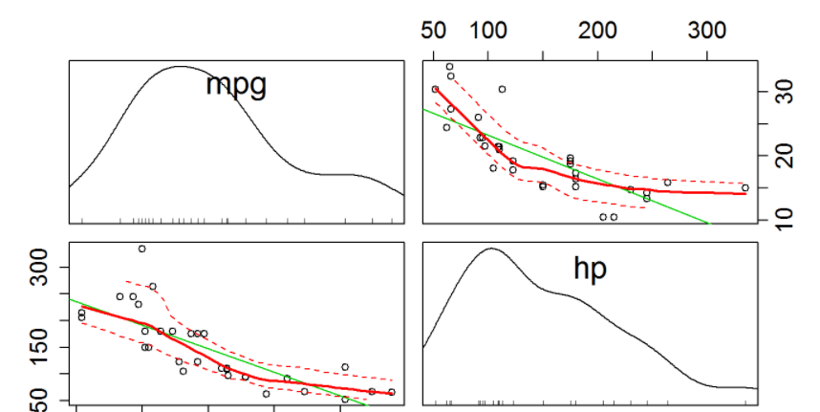
Plot
Here we can see the relationship between variables: miles per gallon(mpg) and horsepower(hp).
library(car) scatterplot.matrix(~mpg+hp, data=mtcars, cex.axis=1.5)

Slide 6
Thank you

